Slide 1
Unit - II

Slide 2
Mathematical model
  A mathematical model is a description of a system using mathematical concepts and language.
    Mathematical models are usually composed of relationships and variables.
      Relationships can be described by operators, such as algebraic operators, functions, differential operators, etc.
      Variables are abstractions of system parameters of interest, that can be quantified.
  Classifications according to their structure
    Linear vs. nonlinear
    Static vs. dynamic
    Explicit vs. implicit
    Discrete vs. continuous
    Deterministic vs. probabilistic (stochastic)(statistical)(non-deterministic
    Deductive, inductive, or floating

Slide 3
Linear vs Nonlinear
  If all the operators in a model exhibit linearity, the resulting mathematical model is defined as linear.
    linear models may have nonlinear expressions in them
      statistical linear model, it is assumed that a relationship is linear in the parameters, but it may be nonlinear in the predictor variables
      if the objective functions and constraints are represented entirely by linear equations, then the model is regarded as a linear model. If one or more of the objective functions or constraints are represented with a nonlinear equation, then the model is known as a nonlinear model
Static vs Dynamic
  A dynamic model accounts for time-dependent changes in the state of the system, while a static (or steady-state) model calculates the system in equilibrium, and thus is time-invariant

Slide 4
Explicit Vs Implicit
  If all of the input parameters of the overall model are known, and the output parameters can be calculated by a finite series of computations, the model is said to be explicit.
  But sometimes it is the output parameters which are known, and the corresponding inputs must be solved for by an iterative procedure,
Discrete vs Continuous
  A discrete model treats objects as discrete, such as the particles in a molecular model or the states in a statistical model; while a continuous model represents the objects in a continuous manner,

Slide 5
Deterministic vs. probabilistic stochastic
  A deterministic model is one in which every set of variable states is uniquely determined by parameters in the model and by sets of previous states of these variables; therefore, a deterministic model always performs the same way for a given set of initial conditions.
  Conversely, in a stochastic model—usually called a "statistical model"—randomness is present, and variable states are not described by unique values, but rather by probability distributions

Slide 6
Deductive, inductive, or floating
  A deductive model is a logical structure based on a theory.
  An inductive model arises from empirical findings and generalization from them.
  Floating model rests on neither theory nor observation, but is merely the invocation of expected structure.

Slide 7
Statistical model
  a class of mathematical model, which embodies a set of assumptions concerning the generation of some sample data, and similar data from a larger population
    assumptions embodied by a statistical model describe a set of probability distributions, some of which are assumed to adequately approximate the distribution from which a particular data set is sampled.
      The probability distributions inherent in statistical models are what distinguishes statistical models from other, non-statistical, mathematical models.
Deterministic model
  a deterministic system is a system in which no randomness is involved in the development of future states of the system.
    A deterministic model will thus always produce the same output from a given starting condition or initial state.
Non-Deterministic model

Slide 8
Statistical models rely on probabilistic forms of description that have wide application over all areas of science
  often consist of a deterministic component, with a random component added that is designed to account for residual variation
choice of model is crucial in formal analysis
  The choice may be influenced by previous experience with comparable data, by subject area knowledge, and by cautious use of what may emerge from exploratory analysis

Slide 9
Noise
  Statistical models combine deterministic and random
  Components
    The random component is often called noise or error and
    The deterministic component is sometimes thought of as the signal
  IThe statistical error as the "rough", and of the model prediction as the "smooth"
    Both noise and error are technical terms
  Use of the word error does not simply that there have been mistakes in the collection of the data,
    though mistakes can of course contribute to making the variability unnecessarily large
  Statistical model
    observation = signal+noise
  After fitting a model
    observation = fitted value+residual
    observation = smooth component+rough component

Slide 10
Sample scenario
  Let us consider a data from an experiment where different weights of roller were rolled over different parts of a lawn, and the depression noted
  The data seem broadly consistent with the assumption of a signal by which depression is proportional to roller weight, as implied by the solid line in figure
  Variation about this signal is reflected in variation in the values for depression / weight

Slide 12
Probability and Sampling distributions
  Probabilities are defined as relative frequencies, and to be more exact as limits of relative frequencies
  When an experiment is conducted, such as tossing coins, rolling a die, sampling for estimating the proportion of defective units, several outcomes or events occur with certain probabilities
  These events or outcomes may be regarded as a variable which takes different values and each value is associated with a probability
  The values of this variable depends on chance or probability. Such a variable is called a random variable

Slide 13
Types of Random Variables
  Discrete Random Variable
    Random variables which take a nite number of values or to be more specific those which do not take all values in any particular range are called discrete random variables
    For example, when 20 coins are tossed, the number of heads obtained is a discrete random variable and it takes values 0,1,...,20
    These are nite number of values and in this range, the variable does not take values such as 2.8, 5.7 or any number other than a whole number
  Continuous Random Variable
    In contrast to discrete variable, a variable is continuous if it can assume all values of a continuous scale
    Measurements of time, length and temperature are on a continuous scale and these may be regarded as examples of continuous variables

Slide 14
A basic difference between these two types of variables is that for a discrete variable, the probability of it taking any particular value is defined
For continuous variable, the probability is defined only for an interval or range
The frequency distribution of a discrete random variable is graphically represented as a histogram, and the areas of the rectangles are proportional to the class frequencies
In continuous variable, the frequency distribution is represented as a smooth curve N.

Slide 15
Frequency distributions
  Observed frequency distributions
    Observed frequency distributions are based on observations and experimentation
  Theoretical or Expected frequency distributions
    Deduce mathematically what the frequency distributions of certain populations should be
    Such distributions as are expected from on the basis of previous experience or theoretical considerations

Slide 16
Basics and terminology
Outcome:- The end result of an experiment.
Random experiment:- Experiments whose outcomes are not predictable.
Random Event:- A random event is an outcome or set of outcomes of a random experiment that share a common attribute.
Sample space:- The sample space is an exhaustive list of all the possible outcomes of an experiment, which is usually denoted by S.

Slide 17
Basics and terminology (contd.)
Mutually Exclusive Event.
Random Variables.
Discrete Random Variable .
Continuous Random Variable.

Slide 18
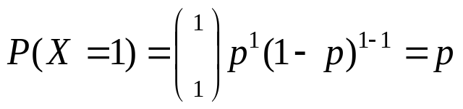
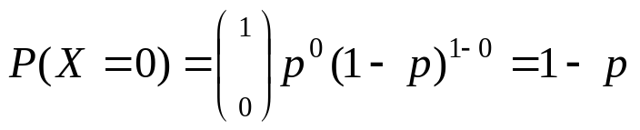
Definitions: Bernouilli
Bernouilli trial: If there is only 1 trial with probability of success p and probability of failure 1-p, this is called a Bernouilli distribution. (special case of the binomial with n=1)
Probability of success:
Probability of failure:

Slide 19
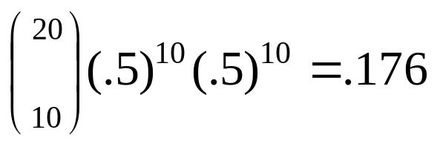
Binomial distribution: example
If I toss a coin 20 times, what’s the probability of getting exactly 10 heads?

Slide 20
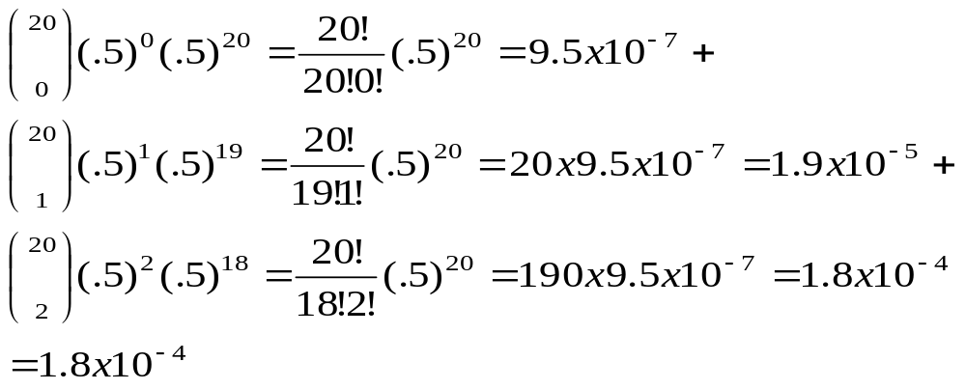
Binomial distribution: example
If I toss a coin 20 times, what’s the probability of getting of getting 2 or fewer heads?

Slide 21
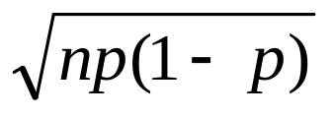
**All probability distributions are characterized by an expected value and a variance:
If X follows a binomial distribution with parameters n and p: X ~ Bin (n, p)
Then:
μ_{x}= E(X) = np
σ_{x}² =Var (X) = np(1-p)
σ_{x} =SD (X)=
Note: the variance will always lie between
0*N-.25 *N
p(1-p) reaches maximum at p=.5
P(1-p)=.25

Slide 22
Characteristics of Bernouilli distribution
For Bernouilli (n=1)
E(X) = p
Var (X) = p(1-p)
Binomial Distribution:-
The Binomial Distribution describes discrete , not continuous, data, resulting from an experiment known as Bernoulli process.

Slide 23
Notation(parameters) for Binomial Distributions.
S and F (success and failure) denote two possible categories of all outcomes.
P(S) = p (p = probability of success)
P(F) = 1 – p = q (q = probability of failure)
n =denotes the number of fixed trials.

Slide 24
Notation (parameters) for Binomial Distributions( contd.)
p =denotes the probability of success in one of the n trials.
q =denotes the probability of failure in one of the n trials.
P(x) =denotes the probability of getting exactly x successes among the n trials.
x = denotes a specific number of successes in n trials, so x can be any whole number between 0 and n, inclusive.

Slide 25
Assumptions for binomial distribution
For each trial there are only two possible outcomes on each trial, S (success) & F (failure).
The number of trials ‘ n’ is finite.
For each trial, the two outcomes are mutually exclusive .
P(S) = p is constant. P(F) = q = 1-p.
The trials are independent, the outcome of a trial is not affected by the outcome of any other trial.
The probability of success, p, is constant from trial to trial.

Slide 26
Methods for Finding Probabilities
Method 1: Using the Binomial Probability Formula.

Slide 27
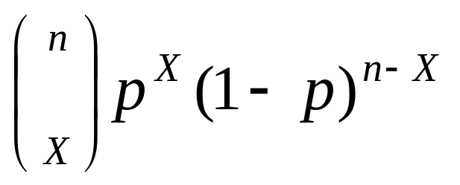
Binomial distribution, generally
Note the general pattern emerging → if you have only two possible outcomes (call them 1/0 or yes/no or success/failure) in n independent trials, then the probability of exactly X “successes”=
n = number of trials
1-p = probability of failure
X = # successes out of n trials
p = probability of success

Slide 28
Binomial example
Take the example of 5 coin tosses. What’s the probability that you flip exactly 3 heads in 5 coin tosses?

Slide 29
Binomial distribution
Solution:
One way to get exactly 3 heads: HHHTT
What’s the probability of this exact arrangement?
P(heads)xP(heads) xP(heads)xP(tails)xP(tails) =(1/2)³ x (1/2)²
Another way to get exactly 3 heads: THHHT
Probability of this exact outcome = (1/2)¹ x (1/2)³ x (1/2)¹ = (1/2)³ x (1/2)²

Slide 30
Binomial distribution
In fact, (1/2)³ x (1/2)² is the probability of each unique outcome that has exactly 3 heads and 2 tails.
So, the overall probability of 3 heads and 2 tails is:
(1/2)³ x (1/2)² + (1/2)³ x (1/2)² + (1/2)³ x (1/2)² + ….. for as many unique arrangements as there are—but how many are there??

Slide 31
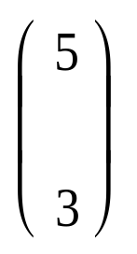
Outcome Probability
THHHT (1/2)³ x (1/2)²
HHHTT (1/2)³ x (1/2)²
TTHHH (1/2)³ x (1/2)²
HTTHH (1/2)³ x (1/2)²
HHTTH (1/2)³ x (1/2)²
THTHH (1/2)³ x (1/2)²
HTHTH (1/2)³ x (1/2)²
HHTHT (1/2)³ x (1/2)²
THHTH (1/2)³ x (1/2)²
HTHHT (1/2)³ x (1/2)²
10 arrangements x (1/2)³ x (1/2)²
The probability of each unique outcome (note: they are all equal)
ways to arrange 3 heads in 5 trials
₅C₃ = 5!/3!2! = 10

Slide 32
∴P(3 heads and 2 tails) = x P(heads)³ x P(tails)² =
10 x (½)⁵⁼31.25%

Slide 33
Binomial distribution function:
X= the number of heads tossed in 5 coin tosses
p(x)
p(x)
x
0
1
2
3
4
5
number of heads
number of heads

Slide 34
A measure of central tendency is a single value that attempts to describe a set of data by identifying the central position within that set of data. As such, measures of central tendency are sometimes called measures of central location. They are also classed as summary statistics. The mean (often called the average) is most likely the measure of central tendency that you are most familiar with, but there are others, such as the median and the mode.

Slide 35

Measures of Central Tendency and dispersion for the Binomial Distribution.
Mean, µ = n*p
Std. Dev. s =
Variance, s ² =n*p*q
Where
n = number of fixed trials
p = probability of success in one of the n trials
q = probability of failure in one of the n trials

Slide 36
Shape of the Binomial Distribution
The shape of the binomial distribution depends on the values of n and p.
Fig.1.Binomial distributions for different values of p with n=10
When p is small (0.2), the binomial distribution is skewed to the right.
When p= 0.5 , the binomial distribution is symmetrical.
When p is larger than 0.5, the distribution is skewed to the left.

Slide 37
Fig.2.Binomial distributions for different values of n with p=0.2
Fig. 2 illustrates the general shape of a family of binomial distributions with a constant p of 0.2 and n’s from 7 to 50. As n increases, the distributions becomes more symmetric.

Slide 38
Binomial distribution is a probability distribution expressing the probability of one set of dichotomous alternatives i.e. success or failure
More precisely, the binomial distribution refers to a sequence of events which posses the following properties:
  An experiment is performed under same conditions for a xed number of trials say, n.
  In each trial, there are only two possible outcomes of the experiment "success" or "failure"
  The probability of a success denoted by p remains constant from trial to trial
  The trials are independent i.e. the outcomes of any trial orsequence of trials do not aect the outcomes of subsequent trials

Slide 39
The probability of success are the successive terms of the binomial expansion (q+p)^{n}
The probable frequencies of the various outcomes in N sets of n trials are N(q+p)^{n}
The frequencies obtained by this expression are known as expected or theoretical frequencies
On the other hand, the frequencies actually obtained by making experiments are called observed frequencies
Generally, there is some dierence between the observed and expected frequencies but the dierence becomes smaller and smaller as N increases

Slide 40
Shape of the Binomial distribution
  The shape and location of the binomial distribution changes as p changes for a given n or as n changes for a given p. As p increases for a xed n, the binomial distribution shifts to the right.
  The mode of the binomial distribution is equal to the value of x which has the largest probability. The mean and mode are equal if np is an integer.

Slide 41
As n increase for a xed p, the binomial distribution moves to right, attens and spreads out. When p and q are equal, the distribution is symmetrical, for p and q may be interchanged without altering the value of any term, and consequently terms equidistant from the two ends of the series are equal. If p and q are unequal, the distribution is skewed. If p is less than 1/2, the distribution is positively skewed and when p is more than 1/2, the distribution is negatively skewed.
If n is large and if neither p nor q is too close to zero, the binomial distribution can be closely approximated by a normal distribution with standardized variable given by

Slide 42
Poisson distribution

Slide 44
Continuous probability distributions

Slide 50
Exponential distribution
  The exponential distribution describes the arrival time of a randomly recurring independent event sequence. If μ is the mean waiting time for the next event recurrence, its probability density function is:

Slide 51
In a simulation, repeated random samples are taken from a specified distribution
Statistics, estimates that are derived from one or other model, can then be calculated for each successive sample
Information is obtained on variation under repeated sampling
  This allows a check on results predicted by statistical theory
  Or it may provide guidance when theoretical results are not available or are of uncertain relevance
Simulation of discrete and continuous random variables
  Random sampling from finite populations

Slide 52
Selecting random numbers and random samples
  It is undesirable to use the same random number seed in two or more successive calls to a function that uses the random number generator
  However, users will sometimes, for purposes of checking a calculation, wish to repeat calculations with the same sequence of random numbers as was generated in an earlier call
  set.seed():
    Sets the seed for the random number generator. The seed for the random number generator is stored in the workspace in a hidden variable (.Random.seed) that changes whenever there has been a call to the random number generator. This ensures that any new simulation will be independent of earlier simulations

Slide 53
When the workspace is saved, .Random.seed is stored as part of the workspace
This ensures that, when the workspace is loaded again, the seed will be restored to its value when the workspace was last saved
Any new simulations will then be independent of those prior to the save
In order to take advantage of this feature, be sure to save the workspace at the end of each session

Slide 54
Sampling from discrete distributions
  Values can be simulated from any of many dierent distributions
  Binomial, Poisson, and normal samples are simulated
  Example: Simulate a random sequence of 10 binary digits (0s or 1s) from a population with a specied proportion of 1s, here 50% (i.e., a Bernoulli distribution):
  set.seed(23286)
    rbinom(10, size=1, p=.5)
    Output: [1] 0 0 0 0 1 0 1 0 1 1
  Example 2:
    To generate the numbers of daughters in a simulated sample of 25 four-child families, assuming that males and females are equally likely
    rbinom(25, size=4, prob=0.5)
    Output:[1] 4 1 1 2 3 3 4 3 1 2 4 0 2 2 3 2 4 1 1 2 2 2 3 2 3

Slide 55
Sampling from discrete distributions
  Simulate the number of raisins in 20 raisin buns, where the expected number of raisins per bun is 3:
    set.seed(9388)
    rpois(20, 3)
    Output:[1] 3 2 4 2 2 3 5 2 4 3 0 2 3 3 7 3 4 4 1 3
Sampling from the normal and other continuous distributions
  The function rnorm() generates random deviates from the normal distribution
  Example:
    To generate 10 random values from a standard normal distribution
    options(digits=2)
    rnorm(10)
    Output: [1] 2.11 0.65 0.55 -1.87 0.18 0.26 -1.44 -0.80 0.95 -0.34

Slide 56
set.seed (21)
# Use to reproduce the data in the figure
par(mfrow=c(2,3))
x <- pretty(c(6.5,13.5), 40)
for(i in 1:5){
y <- rnorm(50, mean=10, sd=1)
hist(y, prob=TRUE, xlim=c(6.5,13.5), ylim=c(0,0.5),main="")
lines(x, dnorm(x,10,1))
}
par(mfrow=c(1,1))

Slide 57
runif(n = 20, min=0, max=1)
Output:[1] 0.16 0.33 0.61 0.34 0.95 0.24 0.93 0.49 0.59 0.38 0.21 0.85 0.53 0.46 0.95
[16] 0.47 0.12 0.72 0.97 0.53
rexp(n=10, rate=3)
Output:[1] 0.440 0.153 0.094 0.054 0.324 0.024 0.045 0.311 0.576 0.149
A sample of n observations can be simulated from the regression model by using
y = b0 + b1x + e
where is normally distributed with standard deviation
Let us assume n = 8, the intercept to be 2, the slope to be 3, and sigma to be 2.5 in our simulation, and we use a xed equally spaced design for the predictor values:

Slide 58
reg<-function(n){
options(digits=3)
x<-seq(1,n)
sigma<-2.5
b0<-2
b1<-3
error<-rnorm(n,sd=sigma)
y<-b0+b1*x+error
return(t(data.frame(x,y)))
}
t<-reg(5)
print(t)
output
[,1] [,2] [,3] [,4] [,5]
x 1.00 2.0 3.00 4.0 5.0

Slide 59
simulate() → Repeatedly simulate data from a fitted model, then refitting to each new set of simulated data
Use: A check on variation under such repeated simulation
  Example: 10 simulations based on the model that was fitted to the roller data
library(DAAG)
attach(roller)
roller.lm <- lm(depression weight, data=roller)
roller.sim <- simulate(roller.lm, nsim=10)
with(roller, matplot(weight, roller.sim, pch=1, ylim=range
(depression)))

Slide 60
Sampling from populations
  Sample()-Function to generate a simple random sample from a given set of numbers
  Example: Names on an electoral roll are numbered from 1 to 9384. To obtain a random sample of 15 individuals the R code is
  > sample(1:9384, 15, replace=FALSE)
  Output: [1] 2905 145 6638 8557 833 4933 1127 7879 3485 966 910 3597 6049 3920 3567

Slide 61
library(lattice)
## Function to generate n sample values; skew population
sampvals <- function(n, exp(rnorm(n, mean = 0.5, sd = 0.3))
## Means across rows of a dimension nsamp x sampsize matrix of
## sample values gives nsamp means of samples of size sampsize.
samplingDist <- function(sampsize=3,nsamp=1000, FUN=mean)
apply(matrix(sampvals(sampsize*nsamp),
ncol=sampsize), 1, FUN)
size <- c(3,10,30)
## Simulate means of samples of 3, 9 and 30;
place in dataframe
df <- data.frame(y3=samplingDist(sampsize=size[1]),
y9=samplingDist(sampsize=size[2]),
y30=samplingDist(sampsize=size[3]))
y <- samplingDist(sampsize=1)
densityplot(~y3+y9+y30, data = df, outer=TRUE,
layout = c(3,1),
plot.points = FALSE,
panel = function(x, ...) {
panel.densityplot(x, ...,
col = "black")
panel.densityplot(y, col = "gray40", lty = 2, ...)

Slide 63
Example:To randomly assign 10 plants (labeled from 1 to 10,
inclusive) to one of two equal-sized groups, control and
treatment
split(sample(seq(1:10)),
rep(c("Control","Treatment"), 5))
Output:
$Control
[1] 6 5 9 8 2
$Treatment
[1] 4 10 3 7 1
sample(1:10, replace=TRUE)
[1] 9 4 5 2 2 3 6 3 7 4

Slide 64
Use y <- rnorm(100) to generate a random sample of size 100
from a normal distribution.
Calculate the mean and standard deviation of y.
Use a loop to repeat the above calculation 25 times. Store the 25 means in a vector named av. Calculate the standard deviation of the values in av.
To simulate samples from normal populations having dierent
means and standard deviations, the mean and sd arguments
can be used in rnorm(). Simulate a random sample of size 20
from a normal population having a mean of 100 and a
standard deviation of 10
The function pexp(x, rate=r) can be used to compute the probability that an exponential variable is less than x. Suppose the time between accidents at an intersection can be modeled by an exponential distribution with a rate of 0.05 per
day. Find the probability that the next accident will occur during the next three weeks
Use the function rexp() to simulate 100 exponential random numbers with rate 0.2. Obtain a density plot for the observations. Find the sample mean of the observations. Compare with the population mean (the mean for an exponential population is 1/rate)

Slide 65
Model Assumptions
  Common model assumptions are normality, independence of the elements of the error or noise term, and homogeneity of variance
    Random sampling assumptions – independence
      sample has been generated by a specific random mechanism
      all population values are chosen with equal probability
      Possible errors
        samples are chosen haphazardly
        the selection mechanism does not guarantee randomness
        Failure of the independence assumption is a common reason for wrong statistical inferences

Slide 66
Checks for normality
  Many data analysis methods rest on the assumption that the data are normally distributed. Real data are unlikely to be exactly normally distributed
    How much departure from normality can we tolerate?
    How can we decide if it is plausible that the data are from a normal distribution?
Examination of histograms
  What checks will detect gross departures?
    By examining the histograms
Normal probability plot
  A better tool for assessing normality is the normal probability plot.
    First the data values are sorted.
    These are then plotted against the ordered values that might be expected if the data really were from a normal distribution.
      If the data are from a normal distribution, the plot should approximate a straight line.

Slide 68
Consider data from an experiment that tested the effect of heat on the stretchiness of elastic bands. Eighteen bands were first tested for amount of stretch under a load that stretched the bands by a small amount (the actual load was 425 g, thought small enough not to interfere with the elastic qualities of the bands). This information was used to arrange bands into nine pairs, such that the two members of a pair had similar initial stretch. One member of each pair, chosen at random, was placed in hot water (60–65 ◦C) for four minutes. The other member of the pair remained at ambient temperature. All bands were then measured for amount of stretch under a load of 1.35 kg weight. Table 3.1 shows the results.

Slide 70
How close to normal is the sampling distribution of the mean?
  Often, the interest is in the normality of the sampling distribution of a mean or other statistic

Slide 72
Formal statistical testing for normality?
  normality tests are used to determine if a data set is well-modeled by a normal distribution and to compute how likely it is for a random variable underlying the data set to be normally distributed.
  Both formal statistical tests for normality and less formal graphical checks are of limited usefulness.
  With small or modest-sized samples, only gross departures are likely to be detected.
  Large samples will show departures from normality that may be too small to have any practical consequence for standard forms of statistical analysis.
  For a statistic such as a mean or a regression slope, the effects of averaging may give a close approximation to normality, even when the underlying population is clearly not normally distributed.

Slide 73
Checking other model assumptions
  Exploratory techniques that can aid in checking whether the standard deviation is the same for all observations in a data set
  a plot of residuals against fitted values may give useful indications
    residuals may tend to fan out as fitted values increase, giving a “funnel” effect, a fairly sure sign that the standard deviation is increasing
    there may be evidence of outliers – one or more unusually large residuals. The major concern may however be to identify points, whether or not outliers, that have such high influence that they distort model estimates

Slide 74
Are non-parametric methods the answer?
  Non-parametric methods have been developed to handle situations where normality or other model assumptions are in question, and where it might be difficult to pose an alternative model. These methods are only sometimes useful, and they still depend on assumptions,
    Requires assurance that these assumptions are realistic. If used in a way that ignores structure in the data that should be modeling, we risk missing insights that parametric methods may provide.
    Building too little structure into a model can be just as bad as building in too much structure

Slide 75
Why models matter – adding across contingency tables?

Slide 76
Regression with a single predictor
  Data displayed as scatter plot
  Straight line model for linear data
  Apply transformation for non-linear data
  X variable on horizontal axis
  Y variable on vertical axis
  If there are many observations, it is often useful to compare the fitted line with a fitted smooth curve. If this differs substantially from an intended line, then straight line regression may be inappropriate

Slide 77
Fitting a line to data
  How accurate is the line?

Slide 78
Summary information – lawn roller example
  library(DAAG)

